Slide 1
Robust Principal Component Analysis for Computer Vision
By:
Fernando De la Torre
Departament de Comunicacions i Teoria del Senyal, Escola d’Enginyeria la Salle,
Universitat Ramon LLull, Barcelona 08022, Spain
Michael J. Black
Department of Computer Science, Brown University, Box 1910,
Providence, RI 02912, USA
Presented By:
Shivanshi Pandya 1001574626
Dhruvin Doshi 1001419924

Slide 2
Outline
Introduction
Previous Work
Energy Function and PCA
Robustifying Principal Component Analysis (other approaches)
Robust PCA
Quantitative Comparison
Computational Issues
Experimental Results
Conclusion and Future Work

Slide 3
Introduction
Principal Component Analysis being a popular technique.
PCA methods useful for solving problems such as face detection, object recognition, tracking and background modelling.
Drawback of PCA: least square estimation technique which fails to account for outliers.
This technique can potentially skew the solution from the desired solution.
Hence, we propose a more robust way of implementing PCA and describe a robust M- estimation algorithm.

Slide 4
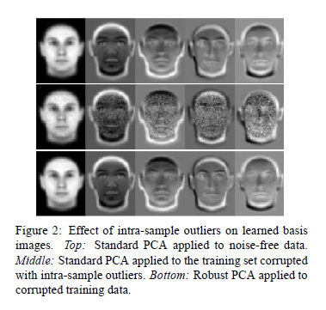
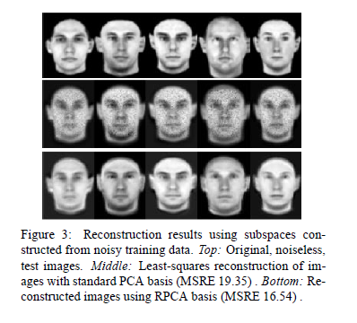
Introduction (Contd.)
Effect of intra-sample outliers on learned basis images
Reconstruction results using subspaces constructed from noisy training data

Slide 5
Previous Work under PCA
We focus here on the Robustness of previous PCA methods.
Treating data set with sample outliers.
Treating data set with intra-sample outliers.
Black and Jepson’s way of robustly recovering the coefficients of a linear combination that reconstructs an input image.
Xu and Yuille address the commonly used PCA learning rules which are first related to energy functions.
These functions are generalized by adding a binary decision field with a given prior distribution so that outliers in the data are dealt with explicitly in order to make PCA robust.

Slide 6
Previous Work under PCA(Contd.)
Black and Jepson addressed the issue of view based tracking of articulated objects using view based representation.
Tracking a previously viewed object in an image sequence.
PROBLEM: As view of the object changes due to motion or when motion of camera fails to detect the same.
THEIR APPROACH: Given a learned basis set, B and J addressed the issue of robustly recovering the coefficients of a linear combination that reconstructs an input image.

Slide 7
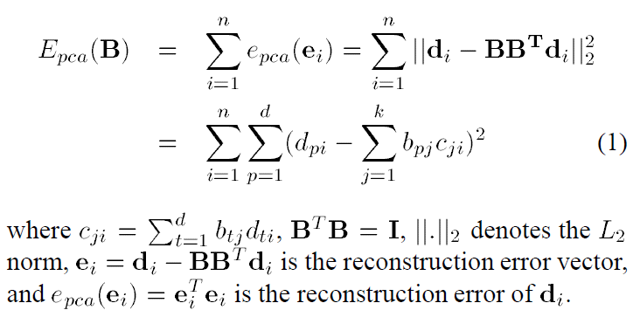
Energy Functions and PCA
Let D = [d1 d2 ::: dn] = [d1 d2 ::: dd]T be a matrix D belongs to R^(d x n) 1, where each column di is a data sample (or image), n is the number of training images, and d is the number of pixels in each image.
Here, training data is zero mean, otherwise the mean of the entire data set is subtracted from each column di.
Let the first k principal components of D be B =[b1; :::; bk] belongs to R^(d x k).

Slide 8
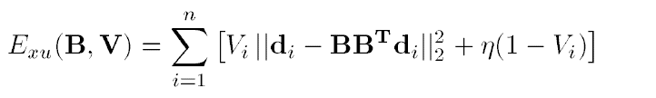
Robustifying PCA
The above methods for estimating the principal components are not robust to outliers that are common in training data and that can arbitrarily bias the solution.
The above problem is solved in computer vision by replacing the standard estimation of the covariance matrix, (Tau), with a robust estimator of the covariance matrix.
Xu and Yuille have proposed an algorithm that generalizes the energy function (1), by introducing additional binary variables that are zero when a data sample (image) is considered an outlier.

Slide 9
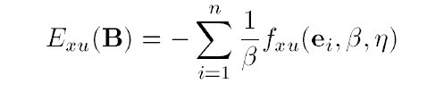
Robustifying PCA ( Contd.)
Minimizing the previous equation:
This involves a combination of discrete and continuous optimization problems and Xu and Yuille derive a mean field approximation to the problem which, after marginalizing the binary variables, can be solved by minimizing:

Slide 10
Robust Principal Component Analysis
To understand what issues were faced by Xu and Yuille helps understand the how this version of robust PCA works.
Problems in Previous Approaches:
A single “bad” pixel value can make an image lie far enough from the subspace that the entire sample is treated as an outlier (i.e. Vi = 0) and has no influence on the estimate of B.
Xu and Yuille use a least squares projection of the data di for computing the distance to the subspace; that is, the coefficients which reconstruct the data di are ci = BT di. These reconstruction coefficients can be arbitrarily biased for an outlier.
A binary outlier process is used which either completely rejects or includes a sample.

Slide 11
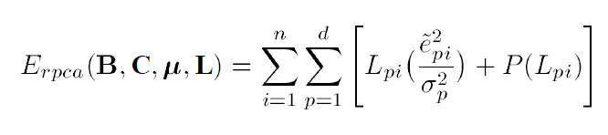
Robust Principal Component Analysis (Contd.)
The equation below introduces a more general analogue outlier process that has computational advantages.
where 0 <= Lpi <= 1 is now an analog outlier process that depends on both images and pixel locations and P(Lpi) is a penalty function.

Slide 12
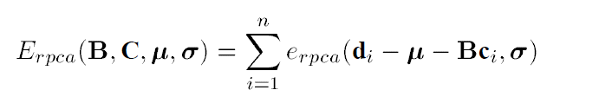
Robust Principal Component Analysis (Contd.)
We explicitly solve for the mean ‘u’ in the estimation process.
In the least-squares formulation the mean can be computed in closed form and can be subtracted from each column of the data matrix D.
In the robust case, outliers are defined with respect to the error in the reconstructed images which include the mean.
The mean can no longer be computed and first subtracted. Instead it is estimated (robustly) analogously to the other bases.
Exploiting the relationship between outlier processes and robust statistics , minimizing the previous equation is equivalent to minimizing the following robust energy function:

Slide 13
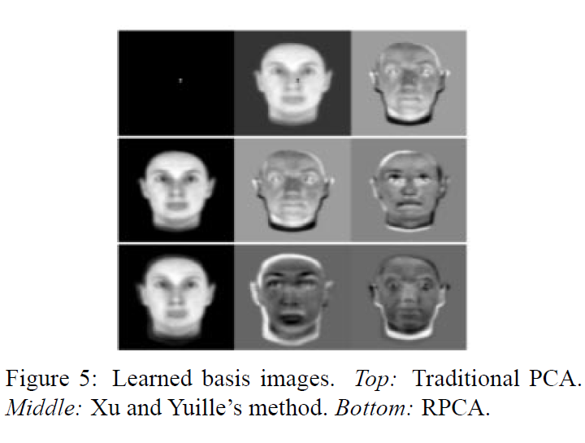
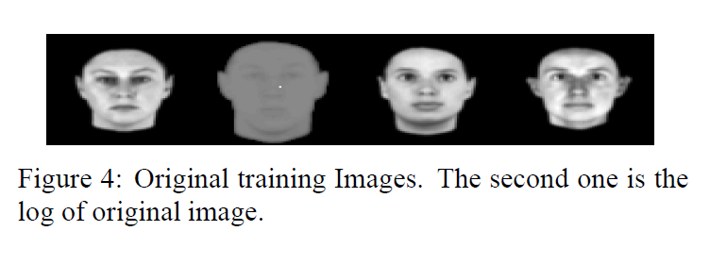
Quantitative Comparison
Consider the following example:

Slide 14
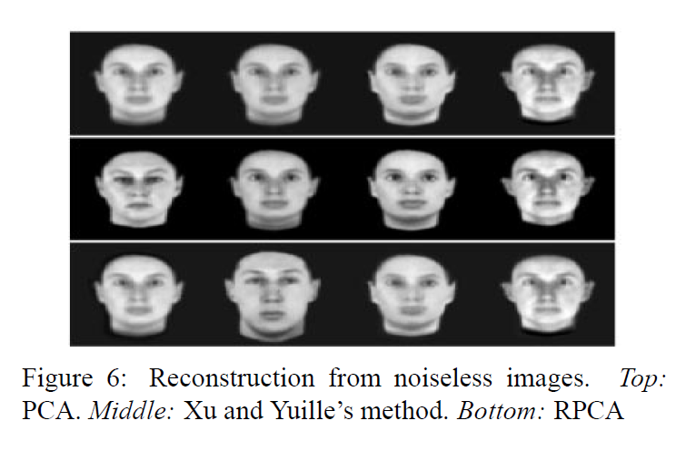
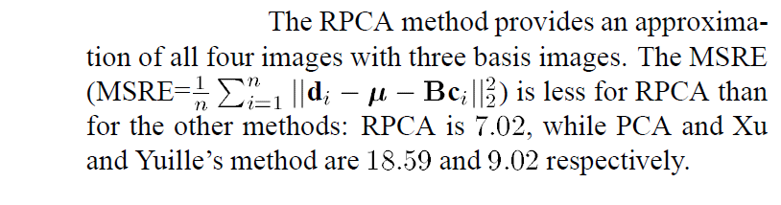
Quantitative Comparison

Slide 15
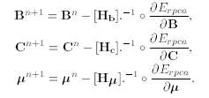
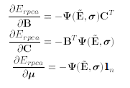
Computational Issues
Estimating the bases B involves computing the solution of d systems of k x k equations, which for large d is computationally expensive.
Rather than directly solving d systems of k x k equations for B and n systems of k x k equations for C, we perform gradient descent with a local quadratic approximation to determine an approximation of the step sizes, to solve for B, C and u.
The robust learning rules for updating successively B, C and u are as follows:

Slide 16
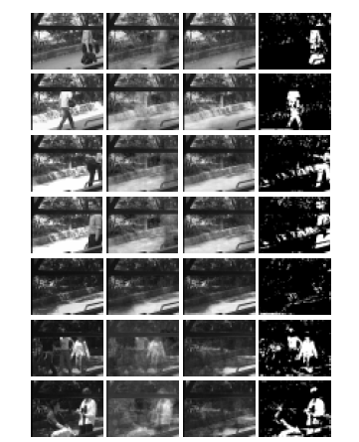

Experimental Results
The behaviour of RPCA is illustrated with a collection of 256 images (120 x 160) gathered from a static camera.
The adjacent figure shows example training images; in addition to changes in the illumination of the static background, 45% of the images contain people in various locations.
We applied standard PCA and RPCA to the training data to build a background model that captures the illumination variation. Such a model is useful for person detection and tracking.

Slide 17
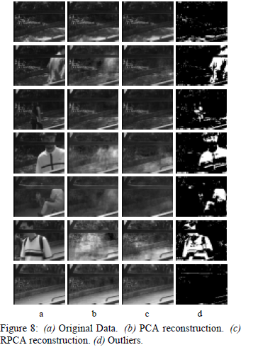
Experimental Results (Contd.)
The second column of Figure shows the result of reconstructing each of the illustrated training images using the PCA basis (with 20 basis vectors).
The presence of people in the scene effects the recovered illumination of the background and results in ghostly images where the people are poorly reconstructed.
The third column shows the reconstruction obtained with 20 RPCA basis vectors.
RPCA is able to capture the illumination changes while ignoring the people.

Slide 18
Conclusion and Future Work
We have presented a method for robust principal component analysis that can be used for automatic learning of linear models.
Furthermore, it extends work in the statistics community by connecting the explicit outlier formulation with robust M-estimation.
Torre and Black are working on applications for robust Singular Value Decomposition, generalizing to robustly factorizing n-order tensors, on adding spatial coherence to the outliers and on developing a robust minor component analysis.

Slide 19
Thank You Questions?

